Slide 1

ANALYTICS AVENUE
TALENTENA EVENT - 2024

Slide 2

ANALYTICS AVENUE - INTRO
Analytics Avenue is a leading educational platform specializing in data science and analytics guidance. Tailored for students, transitioning professionals, and the unemployed, it offers expertise in SQL, Power BI, Python, Data Science, and Machine Learning.
With mentors boasting 5+ years of industry experience, Analytics Avenue emphasizes hands-on learning through real-time projects. Its structured curriculum caters to diverse career stages, providing personalized mentorship and pathways for skill enhancement.
Analytics Avenue serves as a vital resource, equipping individuals to excel in the data-driven landscape through practical learning and industry-aligned guidance.

Slide 3
ABOUT ME
I'm Abinaya Palanisamy, a final-year Computer Science student at Arignar Anna Government Arts College in Trichy, passionate about data analysis.
Completing the Google Data Analyst Professional Certificate signifies my commitment to mastering practical data skills. Engaging in NSS activities and winning competitions highlights my dedication and drive.
I'm all about continuous growth. Learning new skills and pushing boundaries is my thing. Currently interning at Analytics Avenue, I’m diving into Data Analysis through hands-on projects, aligning theory with real-world practice.
With my fervor for data analysis and an unending quest for learning, I’m set to make my mark in the dynamic world of data science.
View My resume

Slide 4

INSIGHTS INTO IMPACTS OF TAMIL NADU SCHEMES - PROBLEM STATEMENT
Analyzing the effectiveness of Tamil Nadu government schemes for 2021-22 is hindered by a lack of a centralized analytical tool. The absence of a systematic framework limits informed decision-making and resource allocation. There is a critical need for an integrated platform to process and interpret scheme-related data, providing actionable insights for policymakers to optimize resource utilization and address diverse socioeconomic needs efficiently.

Slide 5

INSIGHTS INTO IMPACT: ANALYZING TAMILNADU GOVERNMENT SCHEMES AND COMMUNITY RESPONSES
Analyzing Tamil Nadu Government Schemes and Community Responses involves evaluating the effectiveness and public reception of governmental initiatives in the region. This analysis aims to assess the implementation, reach, and impact of these schemes on targeted communities. By studying utilization rates, community engagement, and the tangible outcomes, the objective is to provide insights that aid in refining these initiatives to better serve the needs of the people and improve overall governance.
View the data

Slide 6
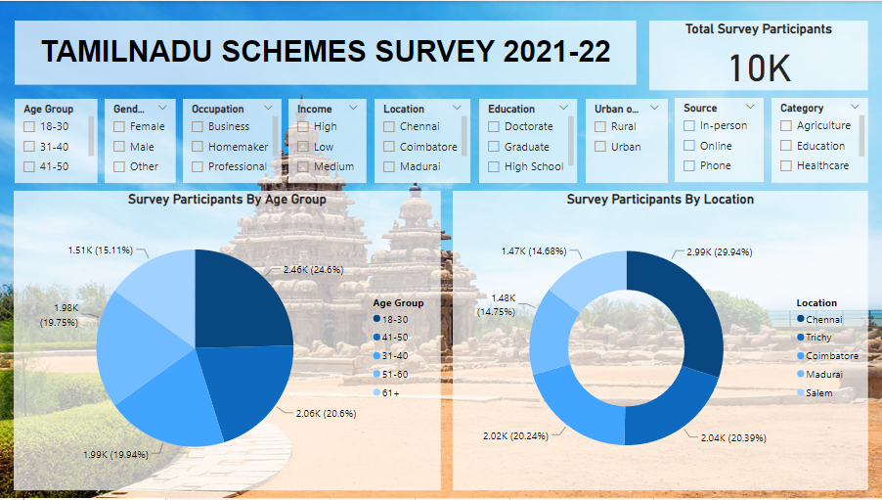

Slide 7
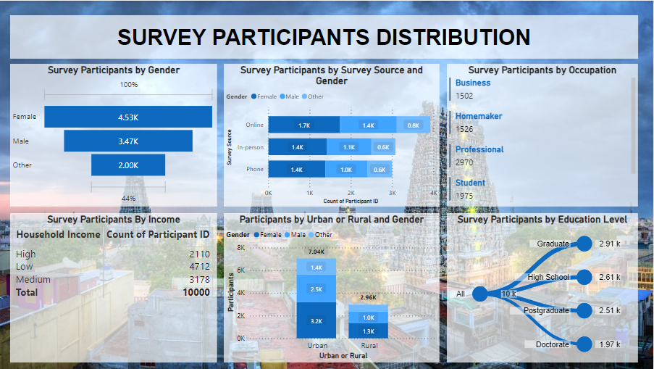

Slide 8
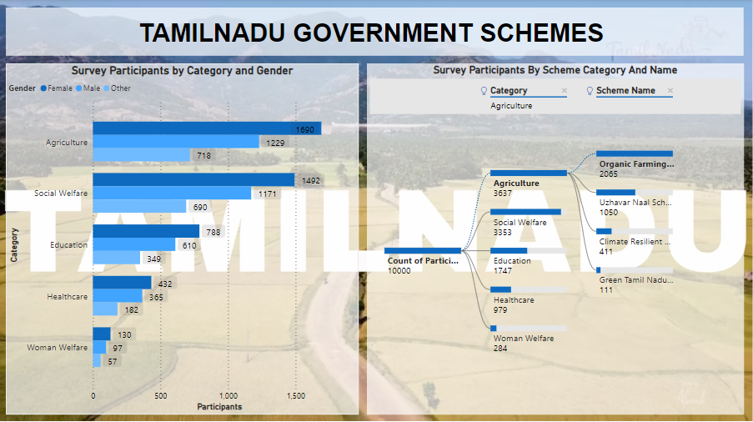

Slide 9
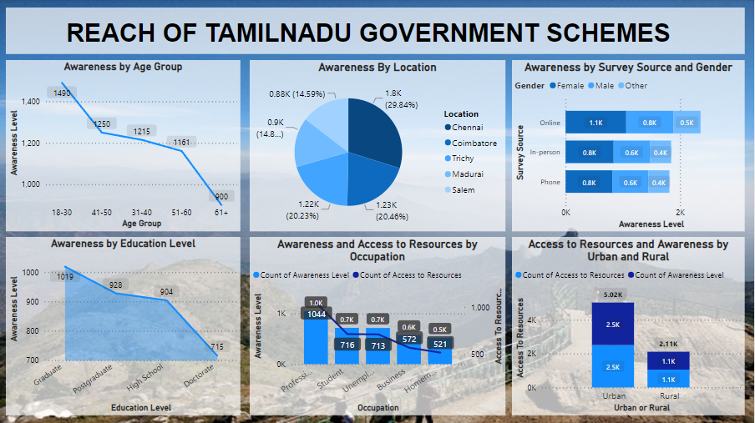

Slide 10
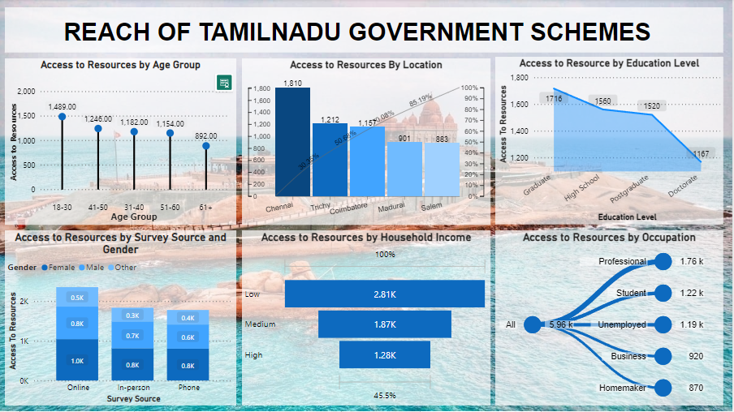

Slide 11
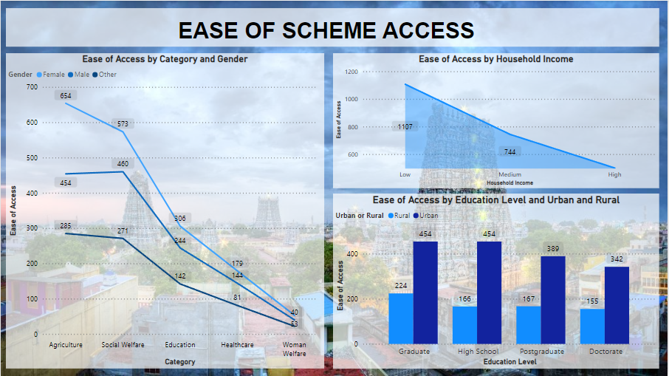

Slide 12
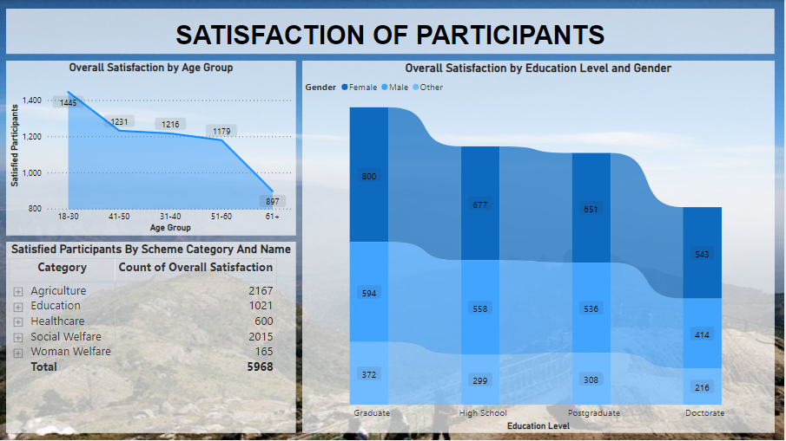

Slide 13
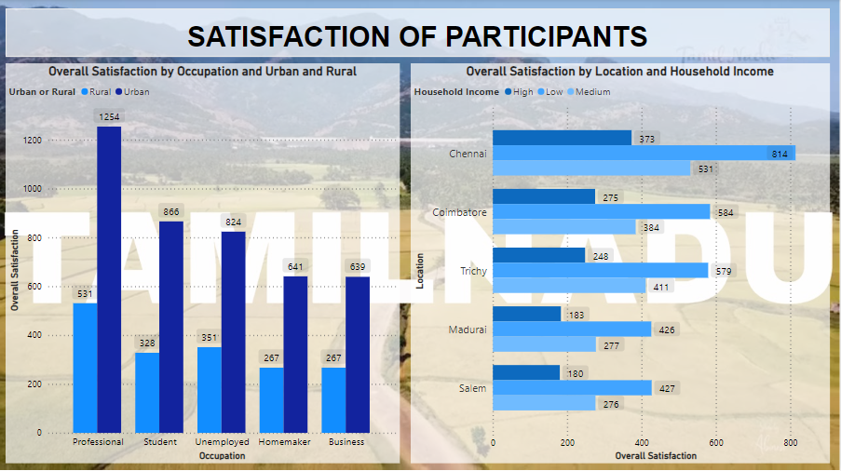

Slide 14
KEY INSIGHTS
Highest number of survey participants belong to the age group 18-30 followed by the age group 41-50.
Participants belong to Chennai are highest in count.
Most of the participants are female.
Most people attended the survey through online.
Most of the participants belong to low-income category.
Urban participants are more than rural participants.
Participants belong to the age group 18-30 have the highest awareness of the Tamil Nadu Government Schemes.
Graduates are more aware of the government schemes than any educational category participants.
People belong to the age group 18-30 are more satisfied with the government schemes than others.
Agricultural schemes got the most satisfaction rate out of all other schemes.

Slide 15

USE CASES
Policy Refinement: Identifying successful aspects and shortcomings of schemes helps refine policies, ensuring they align better with community needs and expectations.
Resource Allocation: Analysis assists in directing resources more effectively by understanding which schemes have a higher impact and demand, optimizing budget allocation.
Enhanced Governance: Insights enable policymakers to make informed decisions, leading to improved governance and better-targeted interventions.
Community Engagement: Understanding community responses helps in fostering greater community engagement and participation in governance and development initiatives.
Improving Accountability: Analysis provides a basis for assessing the efficacy of government programs, enhancing accountability and transparency in public administration.
These use cases demonstrate how analyzing government schemes and community responses can significantly impact policy-making, resource management, and community engagement for more effective governance.

Slide 16

THANK YOU

